Slide 1
Exercise

Slide 2

A blood-based mRNA signature distinguishes people with Long COVID from recovered individuals
Presentation

Slide 3
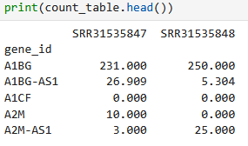
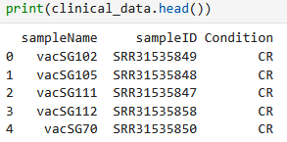
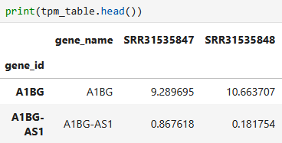
Task 1
Read in data
count table
annotation
tpm data

Slide 4
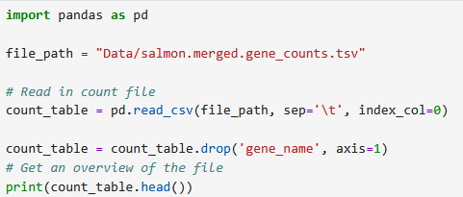
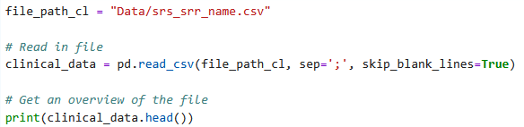
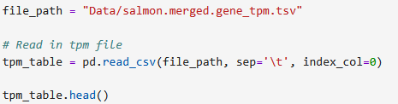
Task 1 - Solution
Read in data
count table
annotation
tpm data

Slide 5
Task 2
Preparation for DESeq
count table: columns = genes; rows = samples (as row names)
  filtered for lowly expressed genes
metadata: columns = group; rows = samples (as row names)

Slide 6
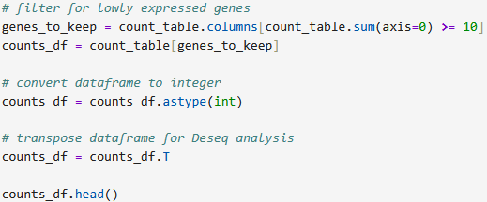
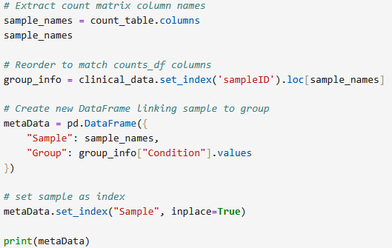
Task 2 - Solution
Preparation for DESeq
count table
metadata

Slide 7
Task 3
Running DESeq2
create DeseqDataSet
run dds.deseq2()
DeseqStats ds & summary

Slide 8
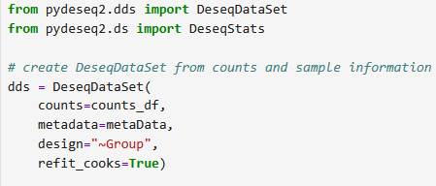


Task 3 - Solution
Running DESeq2
create DeseqDataSet
run dds.deseq2()
DeseqStats ds & summary

Slide 9
Task 4
Get significantly expressed genes
filter upregulated genes
filter downregulated genes

Slide 10
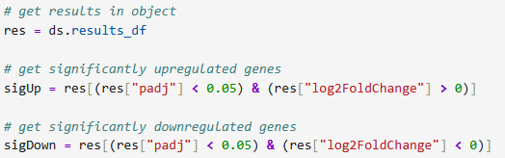
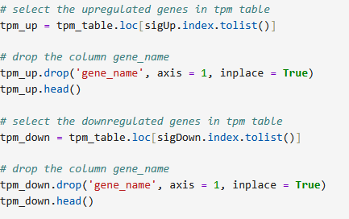
Task 4 - Solution
Get significantly expressed genes
filter upregulated genes
filter downregulated genes

Slide 11
Task 5
Prepare data for heatmap
Map columns to sample names
reorder columns
create final, merged data

Slide 12
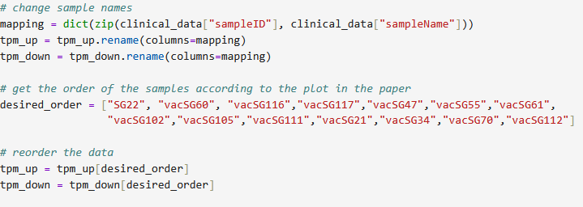
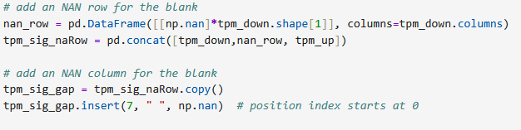
Task 5 - Solution
Prepare data for heatmap
Map columns to sample names
reorder columns
create final, merged data

Slide 13
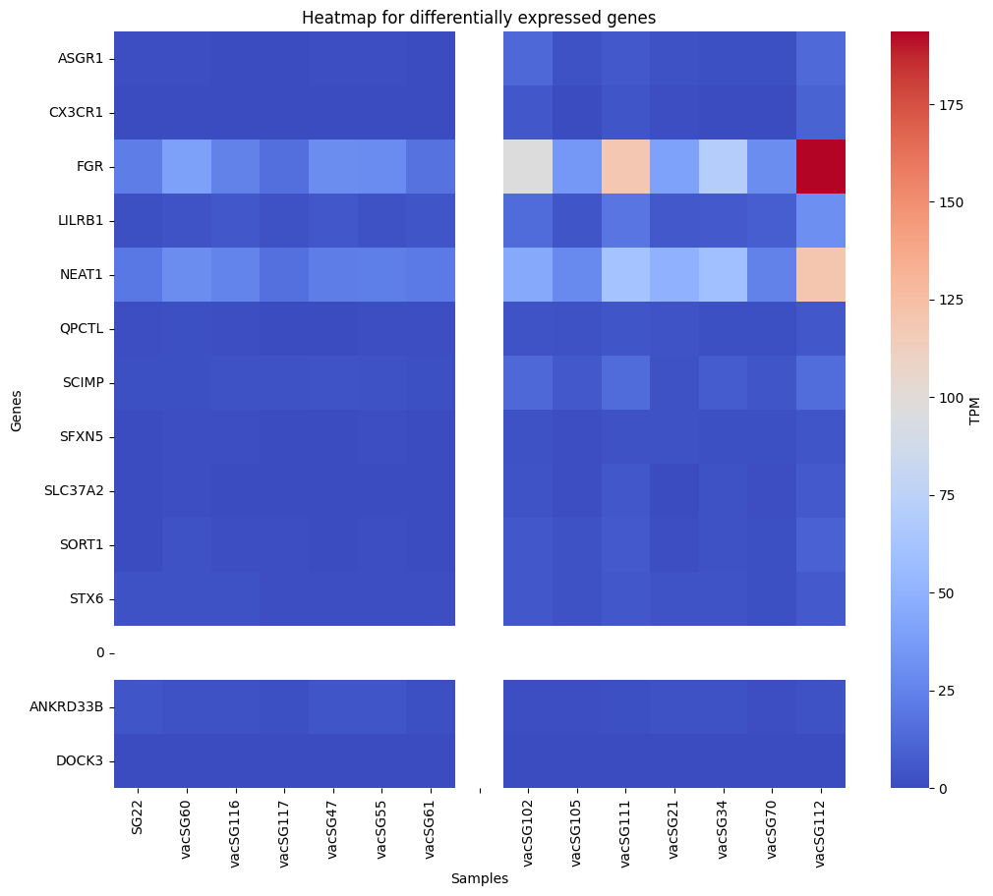
Task 6
Plot heatmap

Slide 14
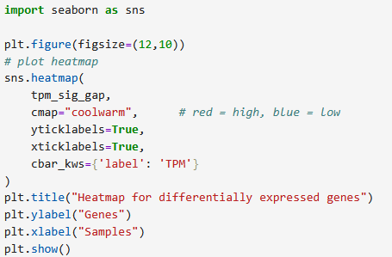
Task 6 - Solution
Plot heatmap

Slide 15
Task 7
Prepare for PCA
combine up&downregulated genes
  columns = genes; rows = samples
scale the values
run PCA

Slide 16

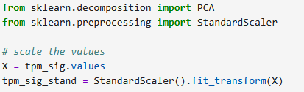
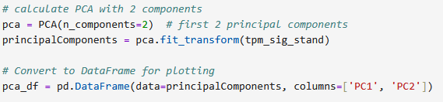
Task 7 - Solution
Prepare for PCA
combine up&downregulated genes
  columns = genes; rows = samples
scale the values
run PCA

Slide 17
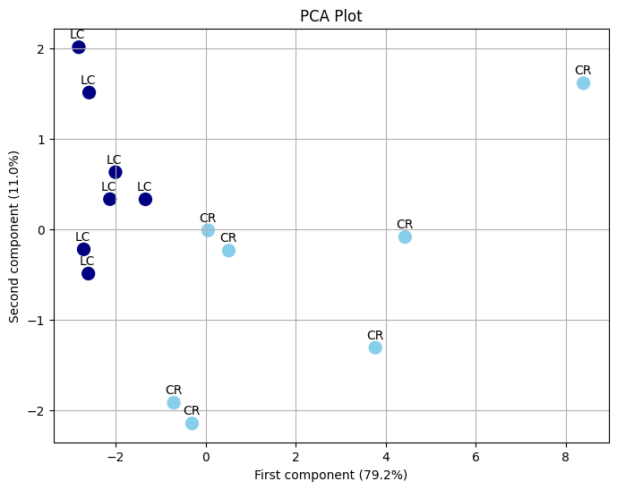
Task 8
Plot PCA
create data including
relevant information
plot PCA scatterplot

Slide 18
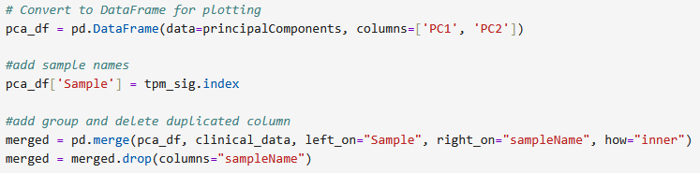
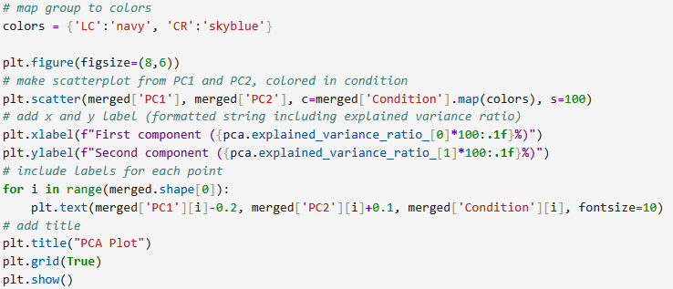
Task 8 - Solution
Plot PCA
create data including
relevant information
plot PCA scatterplot

Slide 19
Task 9
Expression comparison
S1PR1
create data from S1PR1 expression
per sample
get p-value from difference LC/CR

Slide 20
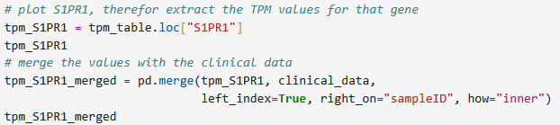
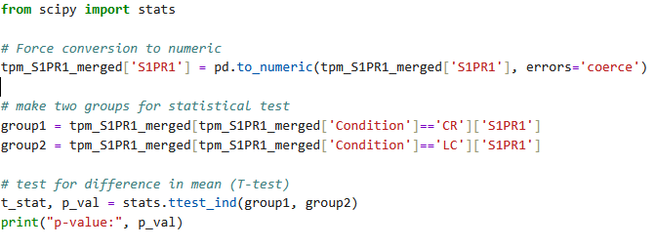
Task 9 - Solution
Expression comparison
S1PR1
create data from S1PR1 expression
per sample
get p-value from difference LC/CR

Slide 21
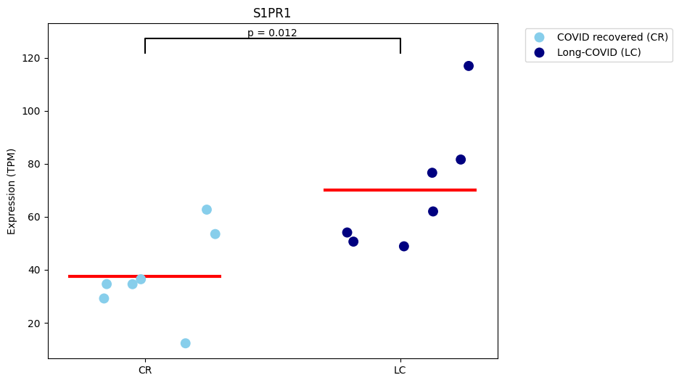
Task 10
Plot expression comparison
S1PR1

Slide 22
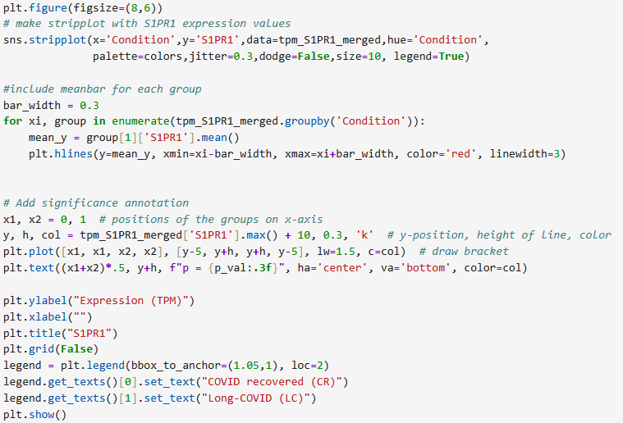
Task 10 - Solution
Plot expression comparison
S1PR1

Slide 23
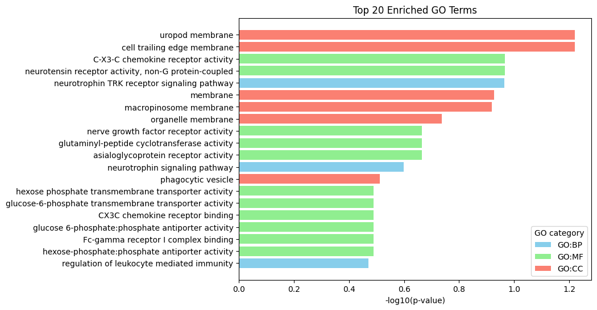
Task 11
GO analysis

Slide 24
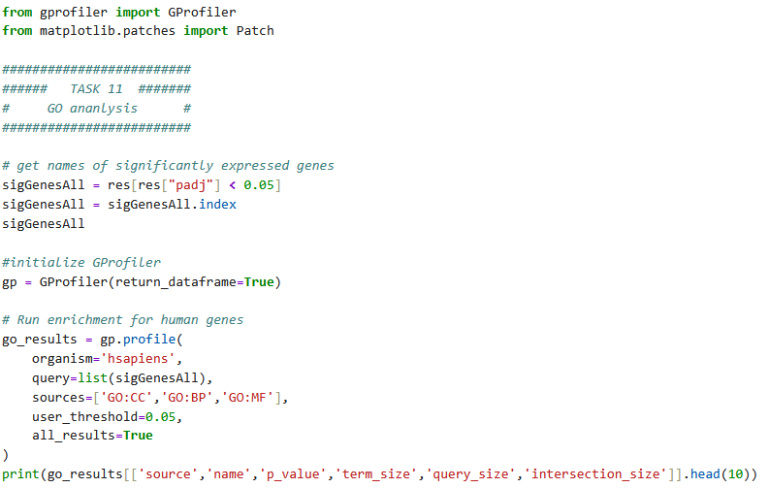
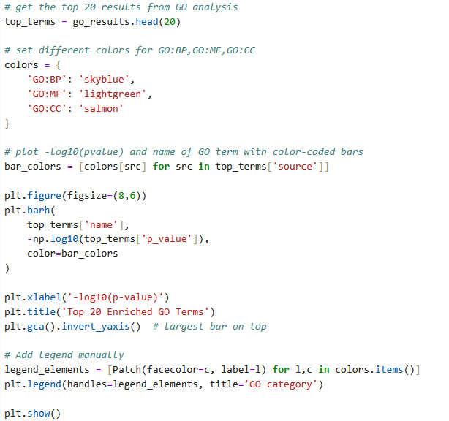
Task 11 - Solution
GO analysis

